Slide 1

An Automated COVID-19 SOPs Monitoring And Management System
GSN: FALL 21-18
Presented by:
Maaheen Yasin (L18-1267)
Inbisat Mudassar Dar (L18-1283)
Ahmad Tameem Kamal (L18-1358)
Advisor: Mr. Hamza Yousuf
Client: Saleem Steel Industries
Evaluation Committee:
Ms. Shazia Haque
Mr. Zeeshan Asif

Slide 2

Brief Recap of the Project
Software Progress: Social Distancing Detection
Software Progress: Face Mask Detection
Hardware Progress
Remaining Tasks
CONTENTS

Slide 3

Brief Recap of the Project
Six Main Deliverables:
Face Mask Detection
Social Distancing Detection
Temperature Sensing
SpO2 Sensing
Warning Gerenation
Automated Door Lock Mechanism
CNN with Linear Regression
YOLO v3 (You Only Look Once)

Slide 4
Software Progress: Social Distancing
Implementation in Real-Time

Slide 5
Software Progress: Social Distancing
The YOLO algorithm was using a pre-trained weighted dataset named COCO that has 80 classes trained.
Why use a Custom Dataset?
Only need one class i.e. People
To improve FPS. Current FPS on Laptop is ranging from 0.7 to 1.
Make it suitable to real-time application
Reduce the workload on the micro-processor

Slide 6
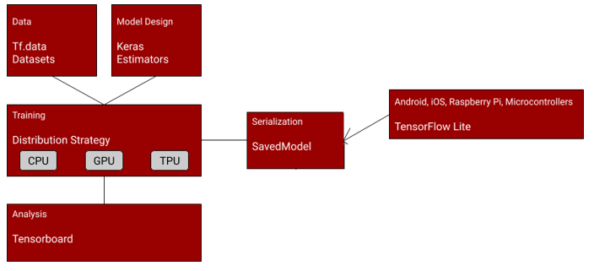
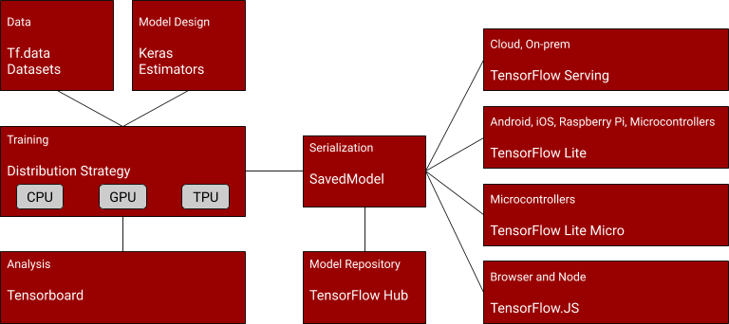
Recap

Slide 7
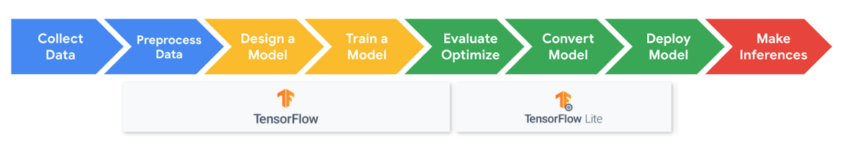
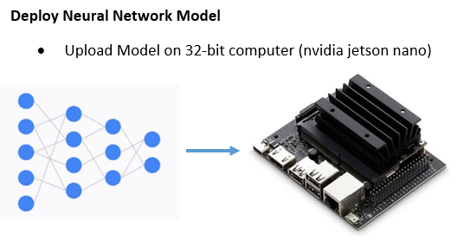
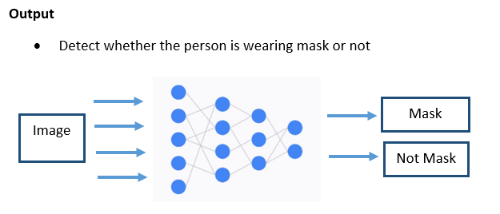
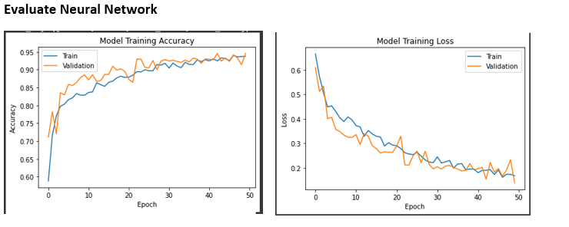
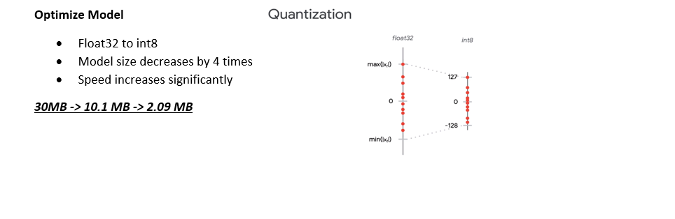
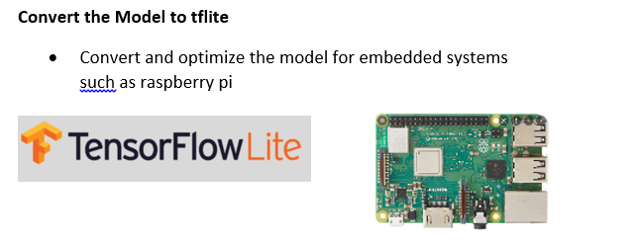
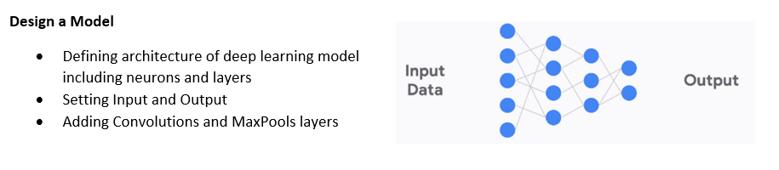
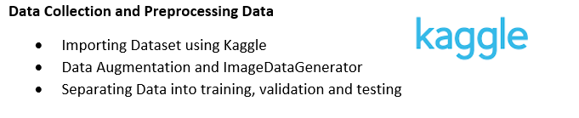
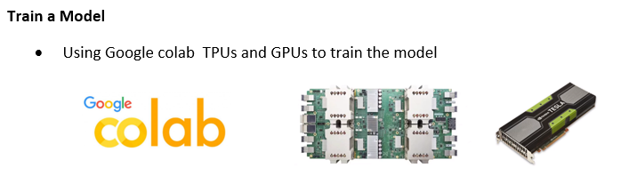
Overview

Slide 8
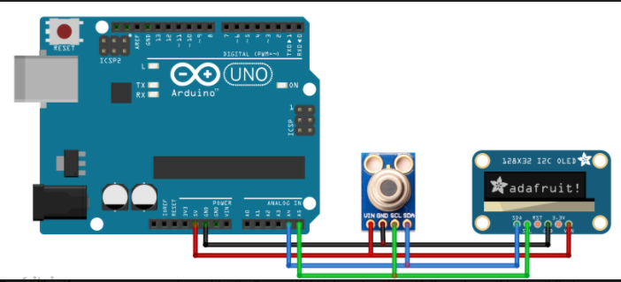
Hardware Progress
MLX90614 connections were made with Arduino
128x32 OLED display was connected
Code was burnt and output was observed

Slide 9
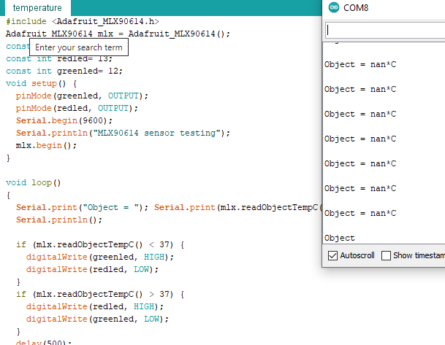
Hardware Progress

Slide 10
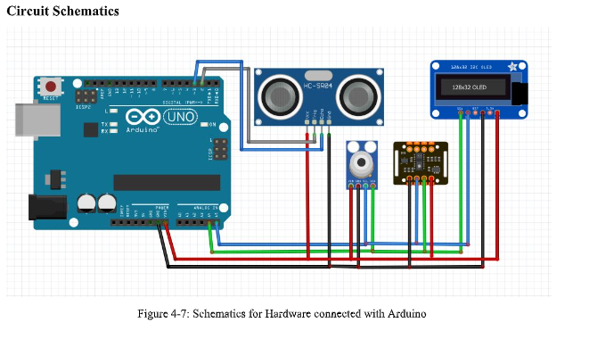
Hardware Progress

Slide 11
Hardware Progress
MLX90614 connections were made with Arduino
Upgrading code for accuracy in temperature sensing
SpO2 sensor interfacing
Display of accurate results on OLED

Slide 12
Remaining Tasks of the FYP
Phase-I: Custom Dataset for Social Distancing Detection
Phase-II: Testing of Deep Learning Models on Hardware
Phase-III: Sensor Testing
Phase-IV: Prototype Assembling
Phase-V: Final Testing of Prototype and Debugging

Slide 13


